Slide 1
Digital Portfolio
STUDENT NAME: Abi anto.A
REGISTER NO AND NMID: 07BE02955B4869D98F1454C794116C28
DEPARTMENT: B.sc Computer Science
COLLEGE: COLLEGE/ UNIVERSITY:Immaculate College /Annamalai University

Slide 2
PROJECT TITLE
College
Library
Management
System

Slide 3


AGENDA
Problem Statement
Project Overview
End Users
Tools and Technologies
Portfolio design and Layout
Features and Functionality
Results and Screenshots
Conclusion
Github Link
3/21/2024 Annual Review

Slide 4
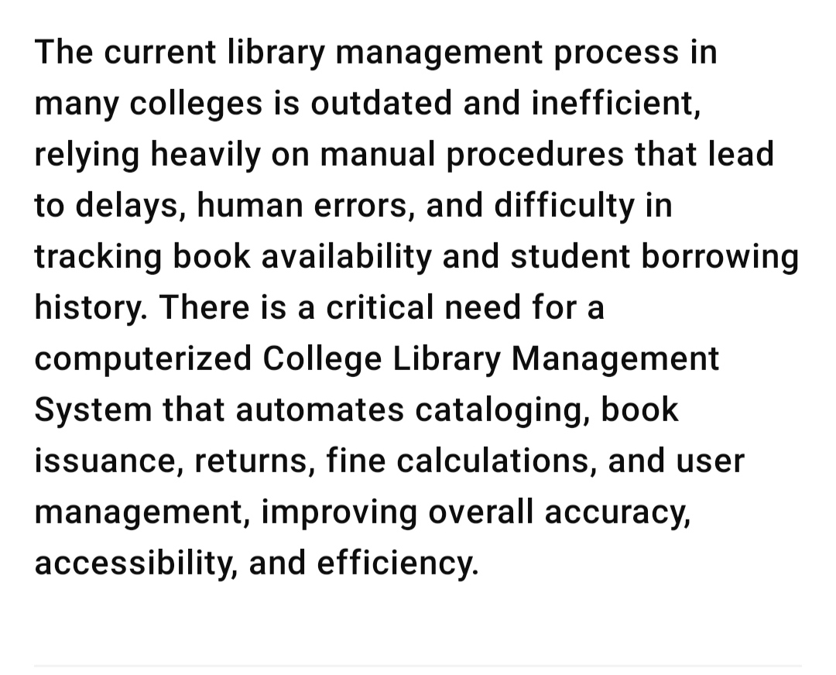

PROBLEM STATEMENT

Slide 5
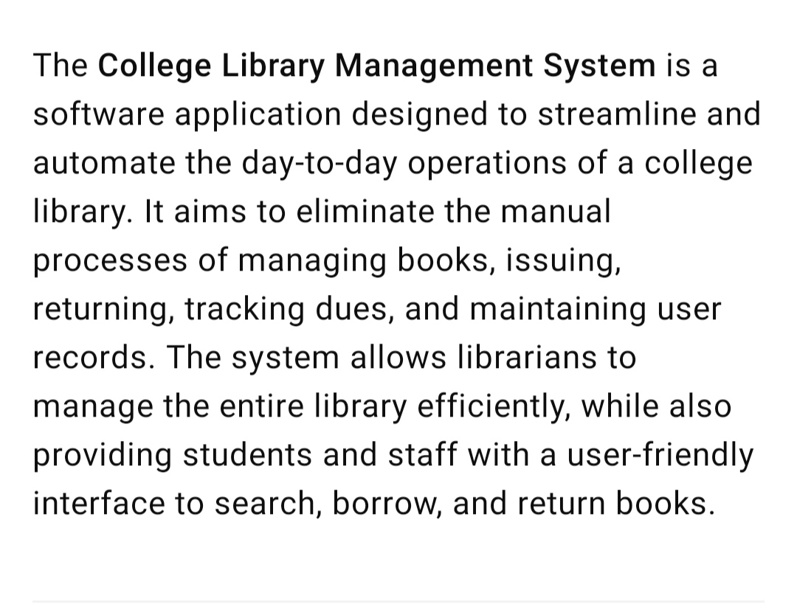

PROJECT OVERVIEW

Slide 6
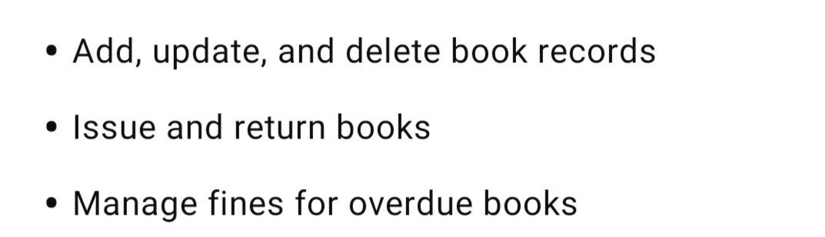


WHO ARE THE END USERS?

Slide 7

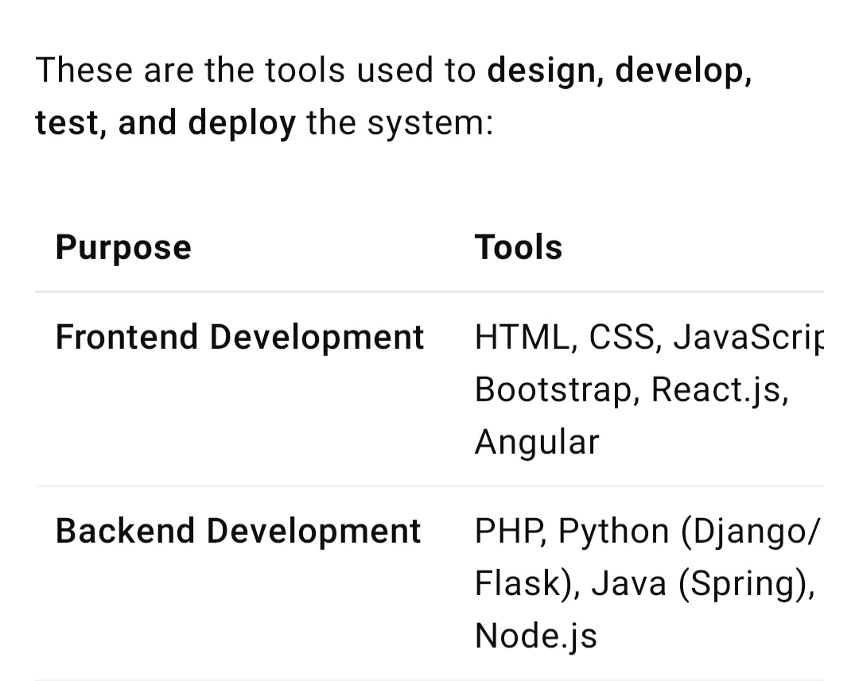
TOOLS AND TECHNIQUES

Slide 8
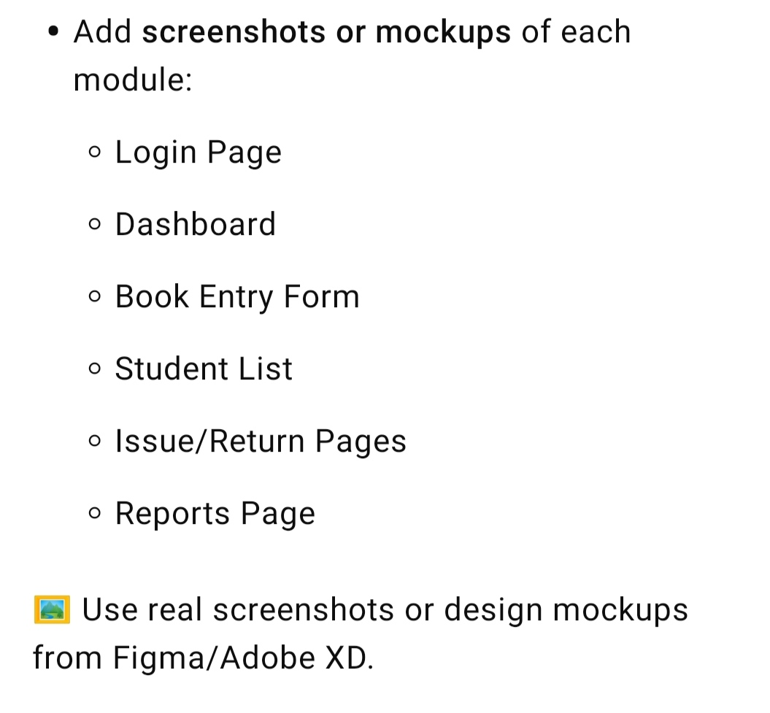
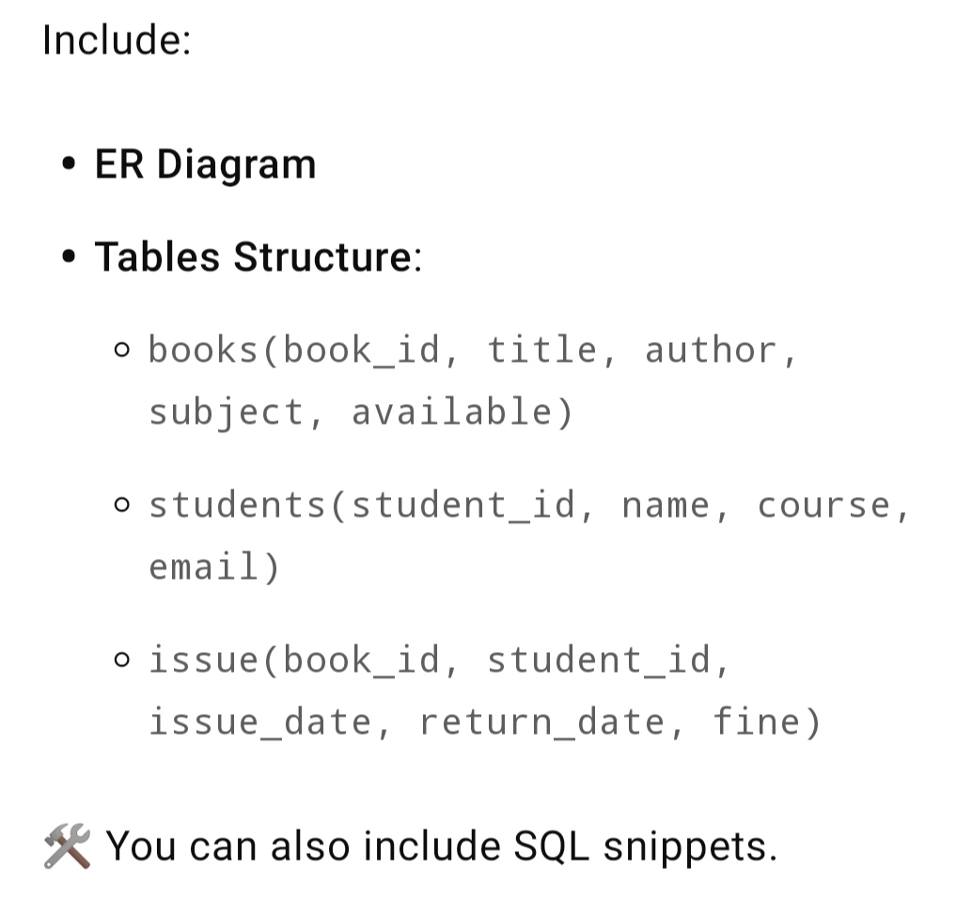
POTFOLIO DESIGN AND LAYOUT
8

Slide 9
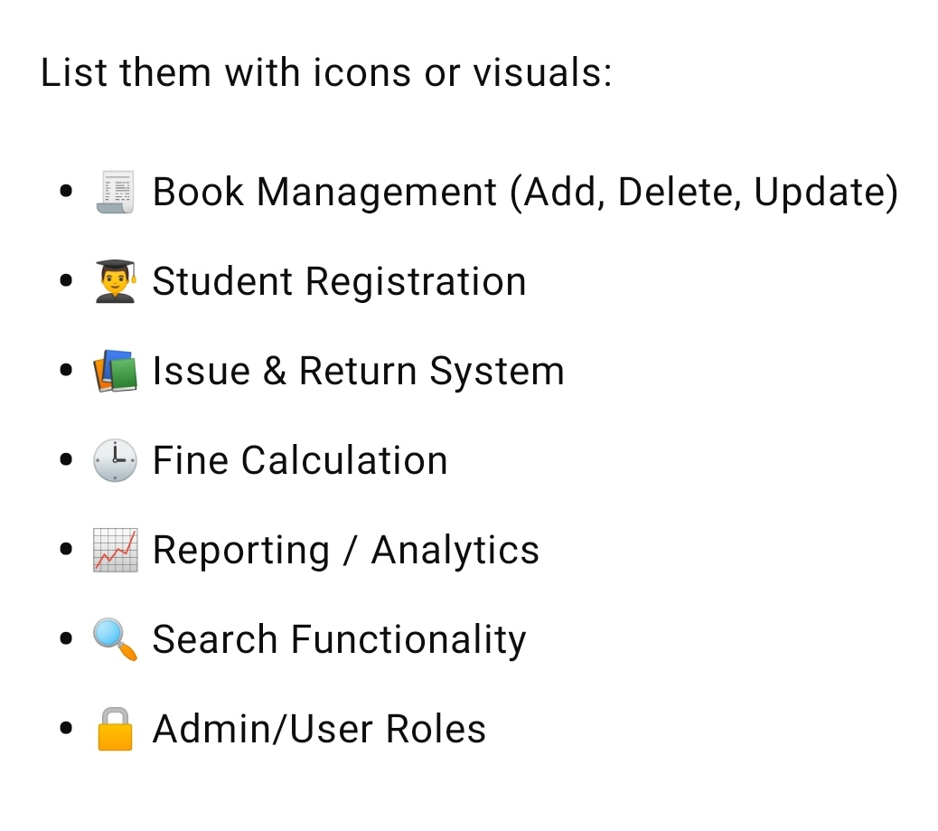
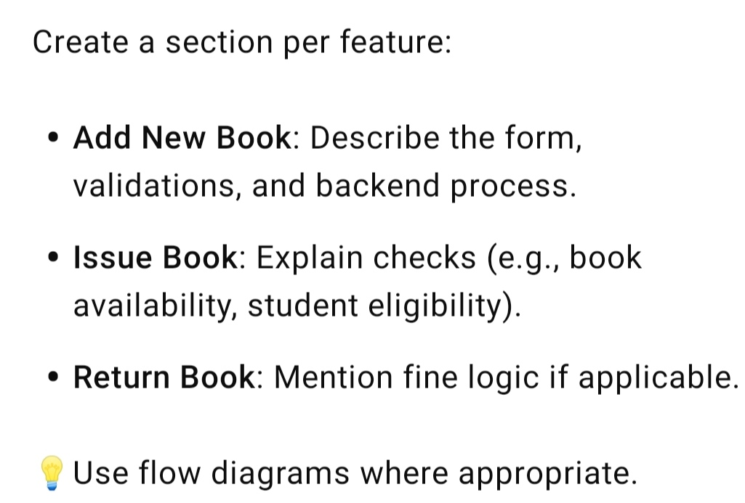
FEATURES AND FUNCTIONALITY

Slide 10
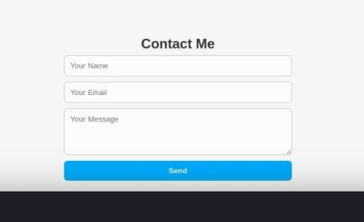

RESULTS AND SCREENSHOTS
3/21/2024 Annual Review
10

Slide 11
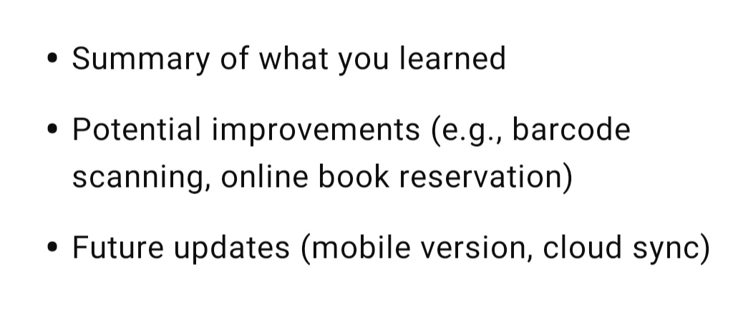
CONCLUSION
11

